Slide 1

Maximum stable sets
Michael Burgher

Slide 2
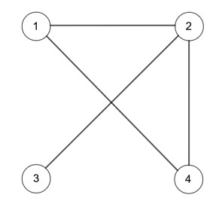
Stable Sets
A Stable Set of vertices is a set of vertices, none of which are adjacent.
The largest stable set in this graph is size 2 (e.g. {1,3} or {3,4}).
Singletons are vacuously independent.

Slide 3
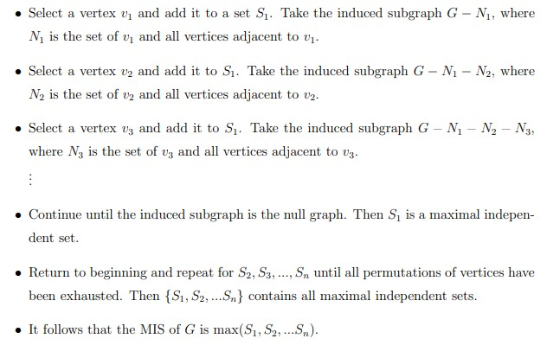
The Solution - Greedy Algorithm
This was an improvement by Ballard (2019) from a previous Greedy Algorithm. Currently, no efficient algorithm exists to find the maximum size stable set of a graph.
We have seen such problems with an H-representation in class and the algorithm clearly looks at sequence of (all) feasible solutions.

Slide 4
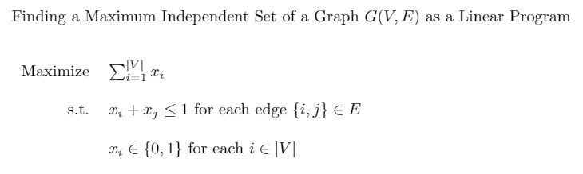
H-Representation

Slide 5




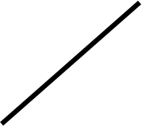





Polytope for an empty 3-vertex graph
011
111
Circuits
x1
x2
x3
x3
001
101
x2
100
010
Lesson: An empty graph corresponds to an n-dimensional hypercube. The circuits are precisely the xi’s.
000
100
x1

Slide 6
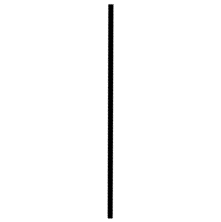
Polytope for a complete 3-vertex graph
x3
x1
x2
x3
Circuits
x1-x2
x1-x3
x2-x3
001
x2
010
Note: A complete graph has a complete polytope containing the origin and precisely one vertex in each dimension. The circuits are precisely all combinations of (xi – xj)’s and all xi’s.
Lesson: All xi’s are circuits in all graphs because a single vertex is a stable set
000
100
x1

Slide 7
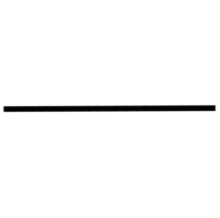

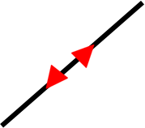
Polytope for a Path on three vertices
x3
x1
x2
x3
Circuits
x1-x3
x2-x3
x1+x2-x3
001
x2
110
010
Lesson: This can be abstracted to suggest that it is possible to have a graph where there is a circuit that needs all ‘dimensional vectors’ to describe it
000
100
x1

Slide 8
Initial Conclusions
For any arbitrary graph on n vertices, xi and –xi are circuits for all i in [n]
Ballard’s Greedy Algorithm constructs maximal sets using circuit walks
More specifically, these are edge walks and are sign compatible.
Other circuits exist besides the xi’s (provided we are dealing with a graph that has edges)

Slide 9
Future Goal: Find a statement that sounds like ‘a graph’s polytope contains a circuit if and only if…’ One Problem: It is difficult to draw shapes in 4 dimensions and there are a lot of graphs.
One Speculation: If a graph G contains an edge ij, then it’s corresponding polytope contains the circuit xi – xj

Slide 10
Future Steps
Theorem: Two vertices of a polytope are adjacent if and only if their midpoint has a unique convex combination of vertices.
To gain a statement that looks like ‘a graph’s polytope has a circuit if and only if …’ we would probably need to look at support minimality.

Slide 11


What questions have you?

